Slide 1
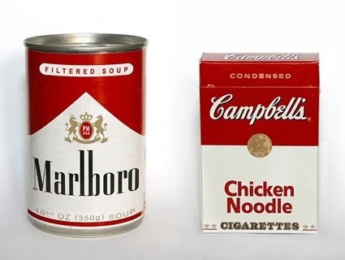
Treating corrupt labels with
Shapley Data Valuation

Slide 2
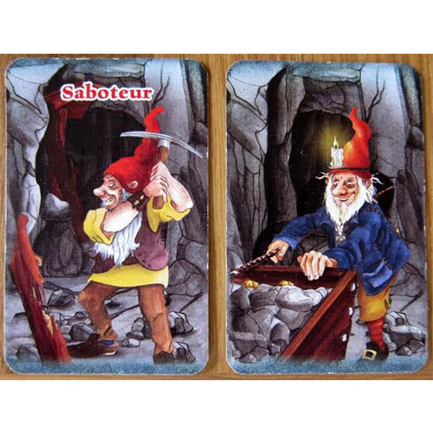
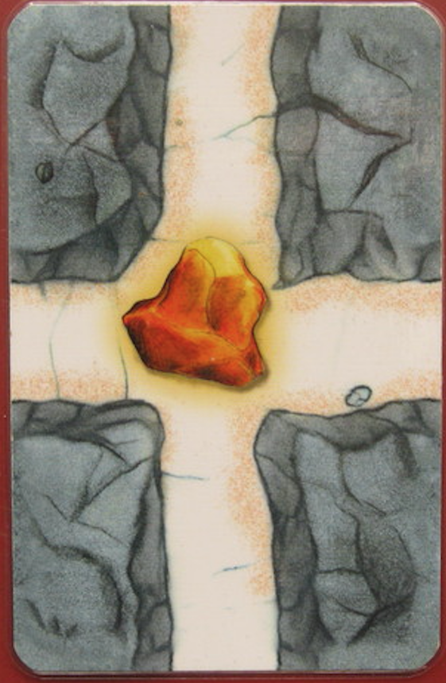
Who is the saboteur?

Slide 3
Who is the saboteur?
𝜙1 | +5
𝜙2 | +10
𝜙3 | -5

Slide 4
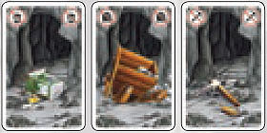
Who is the saboteur?
𝜙1 | +5
𝜙2 | +10
𝜙3 | -5

Slide 5
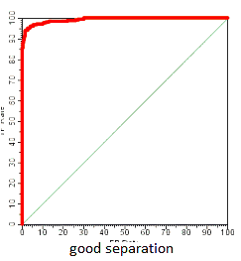
Who is the saboteur?
 |  | X & Y
 |  | X & Y
 |  | X & Y

Slide 6
Who is the saboteur?
𝜙1 | +5 | X & Y
𝜙2 | +10 | X & Y
𝜙3 | -5 | X & Y

Slide 7
Data Shapley values 𝜙
“DATA SHAPLEY introduces a natural formulation for the problem of equitable data valuation in supervised machine learning...
...low Shapley value data effectively capture outliers and corruptions [while]
high Shapley value data inform what type of new data to acquire to improve the predictor.”
Authors of
“What is your data worth? Equitable Valuation of Data”

Slide 8
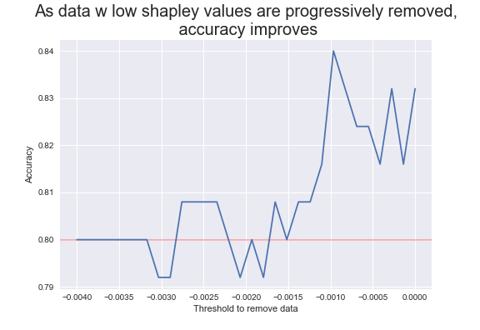
Data Shapley values 𝜙 (OK, it works!)
“DATA SHAPLEY introduces a natural formulation for the problem of equitable data valuation in supervised machine learning...
...low Shapley value data effectively capture outliers and corruptions [while]
high Shapley value data inform what type of new data to acquire to improve the predictor.”
Authors of
“What is your data worth? Equitable Valuation of Data”

Slide 9
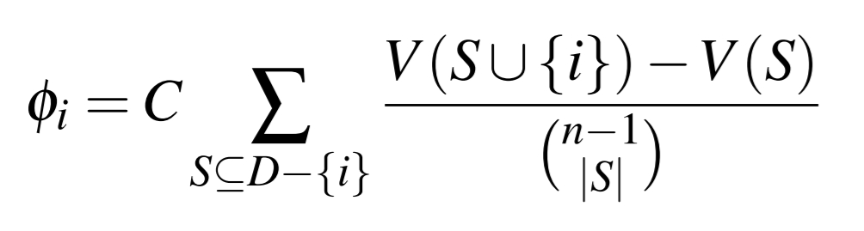
How do you calculate 𝜙?

Slide 10
How do you calculate 𝜙?
Incremental improvement of adding observation {i}

Slide 11
How do you calculate 𝜙?
Average over EVERY subset combination?!

Slide 12
Can we reduce computational costs?

Slide 13
Can we reduce computational costs?
Truncated Monte Carlo (TMC) algorithm
“As we scan the sampled permutation and add more and more data sources, the size of the train data is increasing.
As the train data size increases, the marginal contribution [of] adding the next data source becomes smaller and smaller.”
Authors of
“What is your data worth? Equitable Valuation of Data”

Slide 14
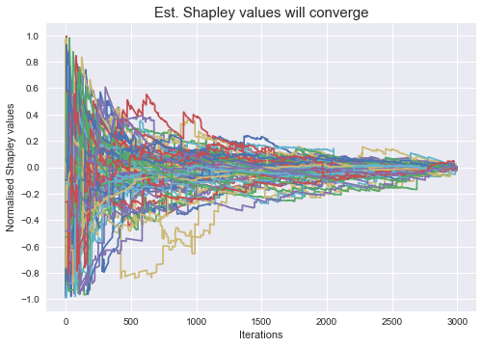
Can we reduce computational costs?
Truncated Monte Carlo (TMC) algorithm
The point: we don’t really need EVERY combination.
“As we scan the sampled permutation and add more and more data sources, the size of the train data is increasing.
As the train data size increases, the marginal contribution [of] adding the next data source becomes smaller and smaller.”
Authors of
“What is your data worth? Equitable Valuation of Data”

Slide 15
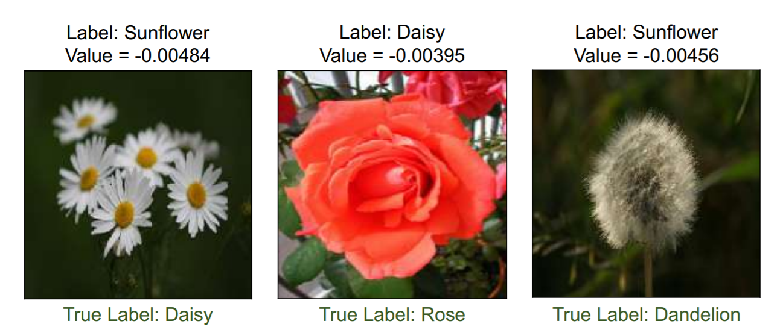
Application 1 / 3: Identifying mislabelled data

Slide 16
Application 1 / 3: Identifying mislabelled data

Slide 17
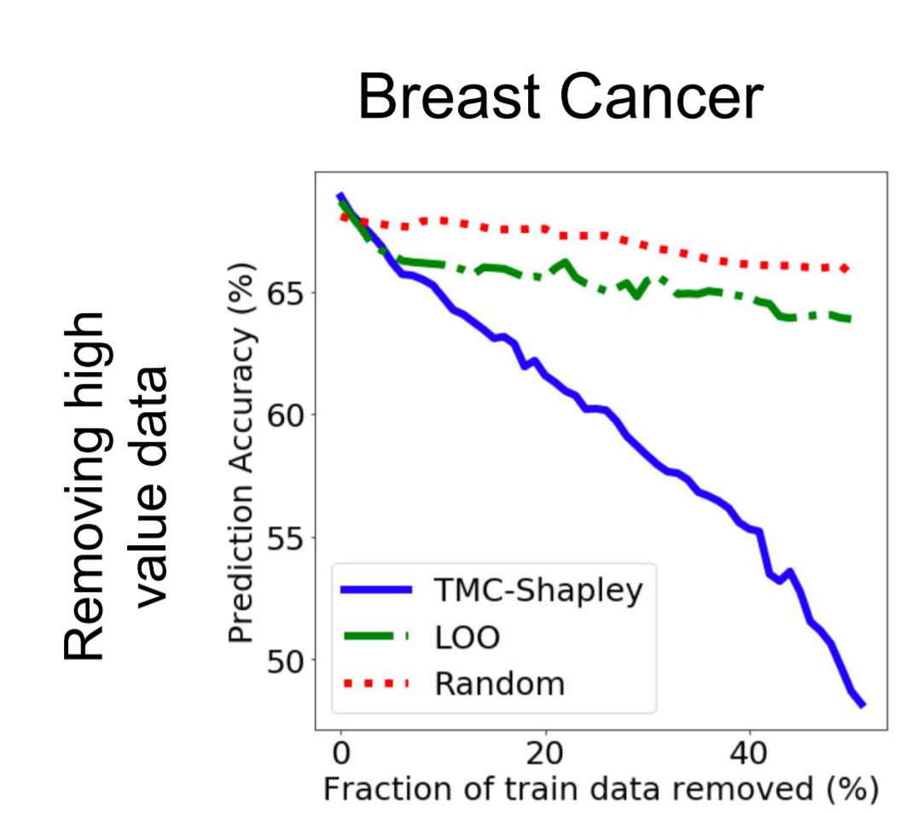
Application 2 / 3: Improving model performance

Slide 18
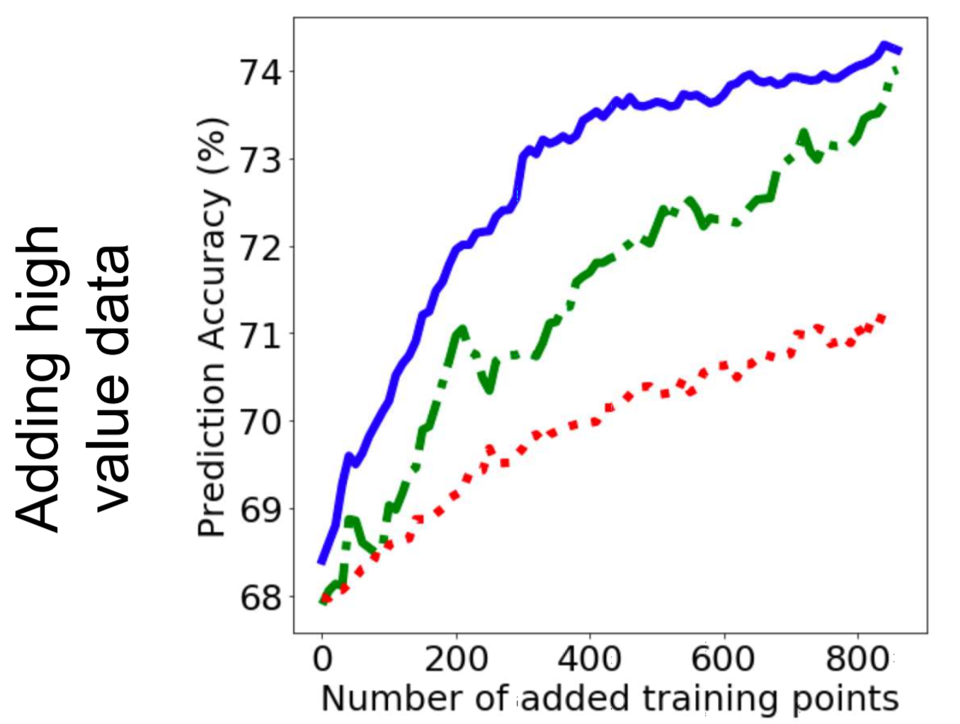
Application 2 / 3: Improving model performance

Slide 19
Application 3 / 3: Titanic dataset
RF Model
Train Set: 596 obs
‘Value set’: 170 obs
Test Set: 125 obs
Use the ‘value’ set to measure the contribution of individual data points in the train set. i.e. How much does each individual datapoint contribute to high accuracy in the value set?

Slide 20
Application 3 / 3: Titanic dataset
Can we beat the baseline model …
by removing training observations?
RF Model
Train Set: 596 obs
‘Value set’: 170 obs
Test Set: 125 obs
Baseline RF Model
Train Set: 596 obs
Discarded
Test Set: 125 obs
Acc: 0.80

Slide 21
Application 3 / 3: Titanic dataset
Removing negatively valued data improves performance.
But is it by luck?

Slide 22
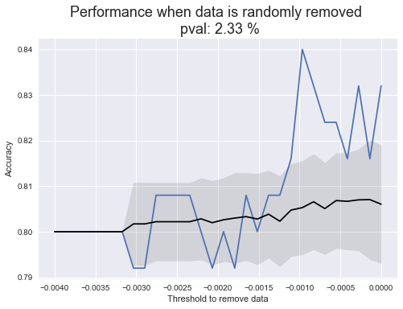
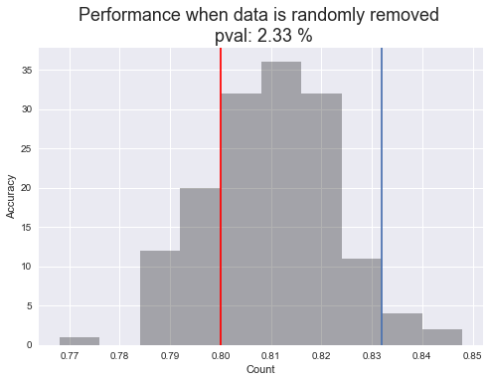
Application 3 / 3: Titanic dataset
150 simulations of removing data by random.

Slide 23
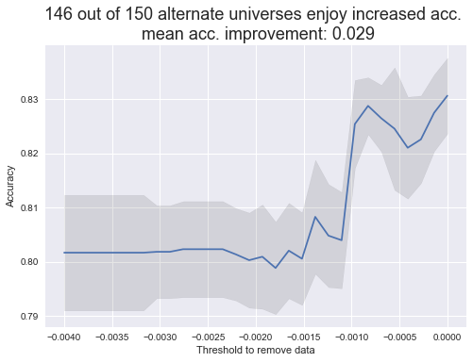
Application 3 / 3: Titanic dataset
After cycling through 150 random_states, accuracy generally improves.
Average improvement : 2.9%
Likelihood of impr. : 146 / 150
The point:
You have to be unlucky to see no improvements in this dataset.

Slide 24
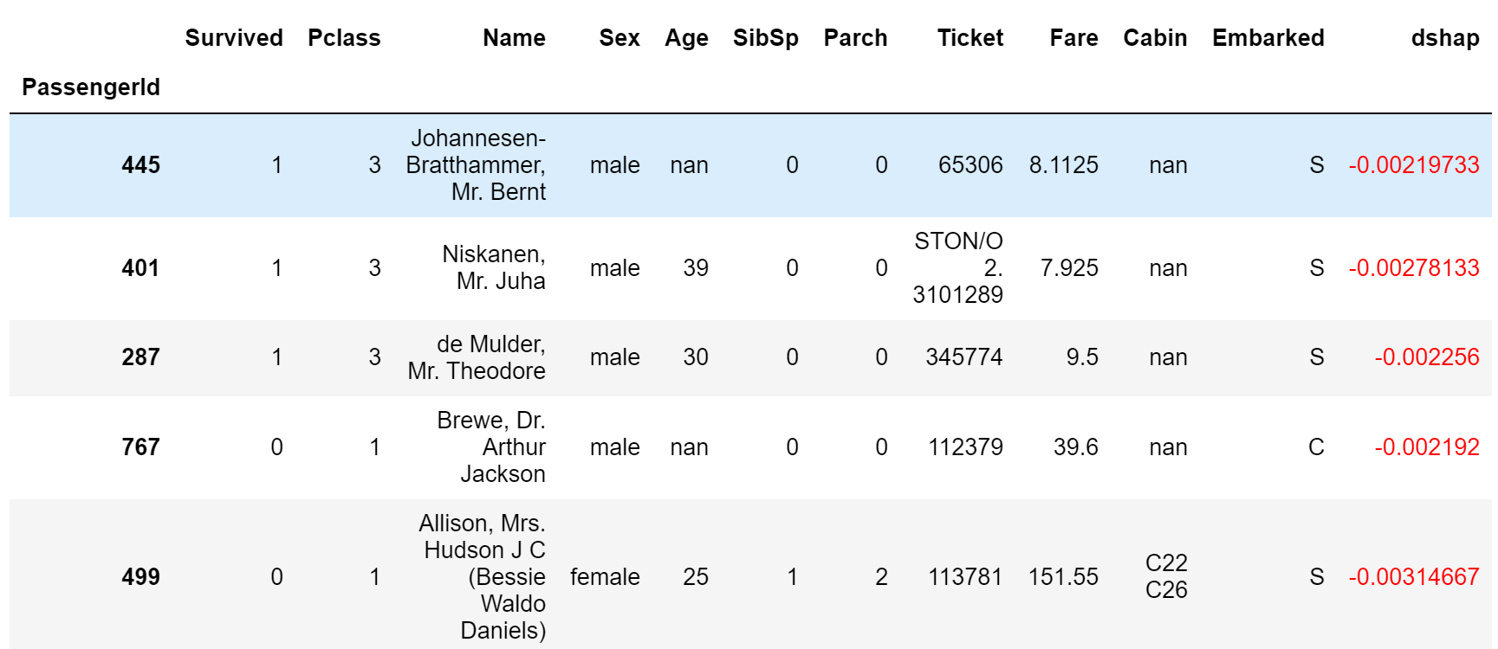
Application 3 / 3: Titanic dataset “bad” data points

Slide 25
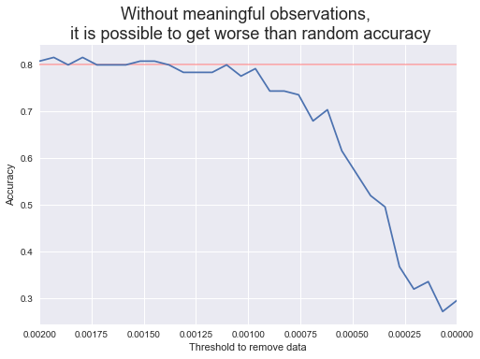

Application 3 / 3: Titanic dataset
30 %
accuracy

Slide 26
References
Author’s implementation in python: https://github.com/amiratag/DataShapley … or google “Data Shapley Github”
“What is your data worth? Equitable Valuation of Data” - Amirata Ghorbani, James Zou https://arxiv.org/abs/1904.02868

Slide 27
Discussion and theories
If we are going to deploy a model in real life noisy data … shouldn’t we expose the model to noisy data too?

Slide 28
Discussion and theories
If we are going to deploy a model in real life noisy data … shouldn’t we expose the model to noisy data too?
If we repeatedly train a model to remove ‘bad’ data … are we inviting data mining bias or some kind of overfitting?

Slide 29
Discussion and theories
If we are going to deploy a model in real life noisy data … shouldn’t we expose the model to noisy data too?
If we repeatedly train a model to remove ‘bad’ data … are we inviting data mining bias or some kind of overfitting?
The quality of the ‘value’ set influences the shapley values heavily. Recommend to fill with ground truth labels if any.
Train Set
‘Value set’
Test Set

